Slide 1



HUE WIZARD
IMAGE
COLORIZATION

Slide 2
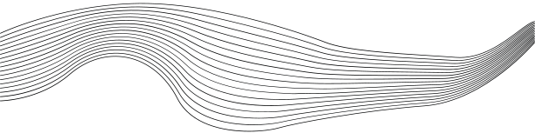
CONTENT
01
INTRODUCTION
02
PROBLEM STATEMENT
03
LITERATURE REVIEW
04
DATASET
05
WORKFLOW
06
RESULTS
HUE WIZARD

Slide 3



INTRODUCTION
Input
Our project, "Hue Wizard," aims to add colour to grayscale images efficiently. Leveraging AutoEncoders, we seek to blend tradition with modern technology for vibrant visual restoration.
Vision
Through deep learning, our project revitalizes black and white imagery. We enhance historical photos, offering a seamless fusion of past and present in visual storytelling.

Slide 4

PROBLEM
STATEMENT
HUE WIZARD
The absence of color in black and white photographs hampers their impact and historical significance. Current manual and automated colorization methods are either time-consuming or lack precision.

Slide 5
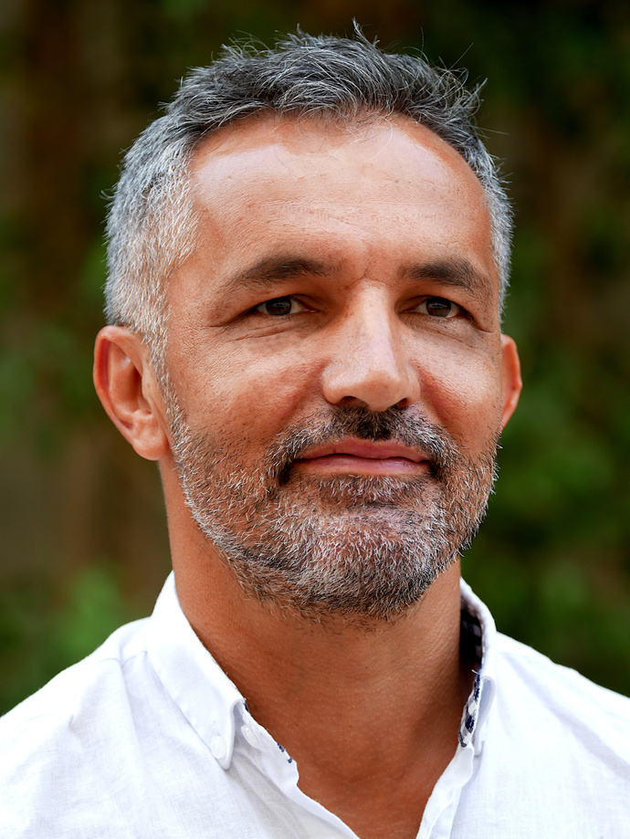

LITERATURE REVIEW
Abishek Khumbar
Title: "Colorization of Black and White Images Using Deep Learning"
Authors: Abhishek Kumbhar, Sagar Gowda, Ruchir Attri, Prof. Ankit Khivasara
Year: October 2021
Algorithm Used: CNN, Generative Adversarial Networks (GAN)
Advantages:
Capable of handling high-resolution images
Categorized colorization based on scenery, background, and artistic elements
Limitations:
Low image quality
Complexity of the models
Yushu Ren
Title: "A Method for Coloring Low-resolution Black and White Old Movies through Object Understanding"
Authors: Ming Fang, Yu Song, Xiaoying Bai, Yushu Ren, Shuhua Liu
Year: September 2021
Algorithm Used: Conditional Generative Adversarial Nets (CGAN)
Advantages:
Quick and accurate coloring process
Limitations:
Unsatisfactory coloring effect
HUE WIZARD

Slide 6
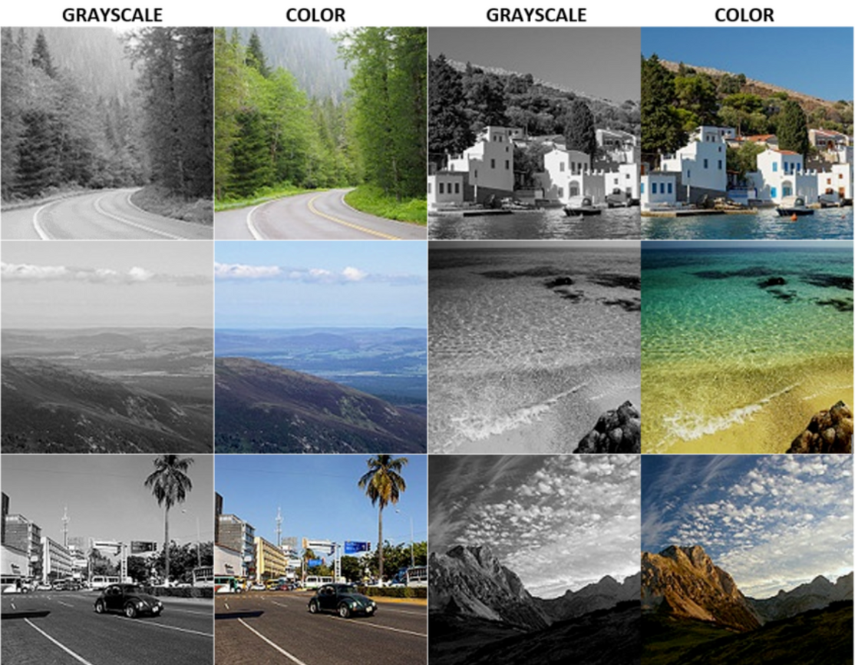

DATASET
HUE WIZARD

Slide 7
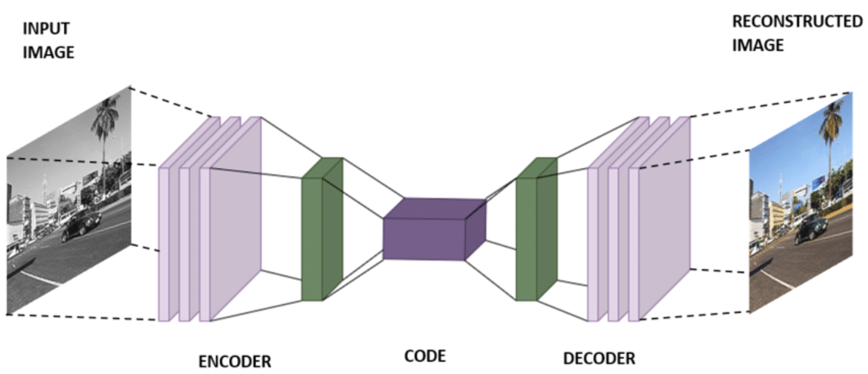

ARCHITECTURE
HUE WIZARD

Slide 8
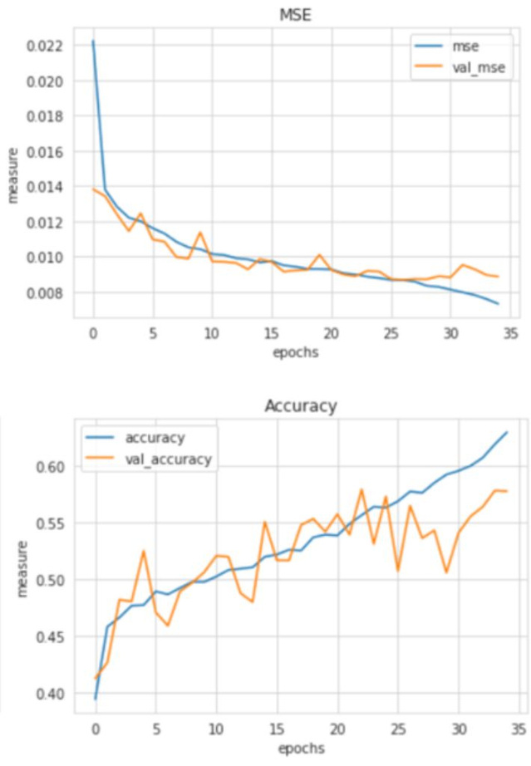
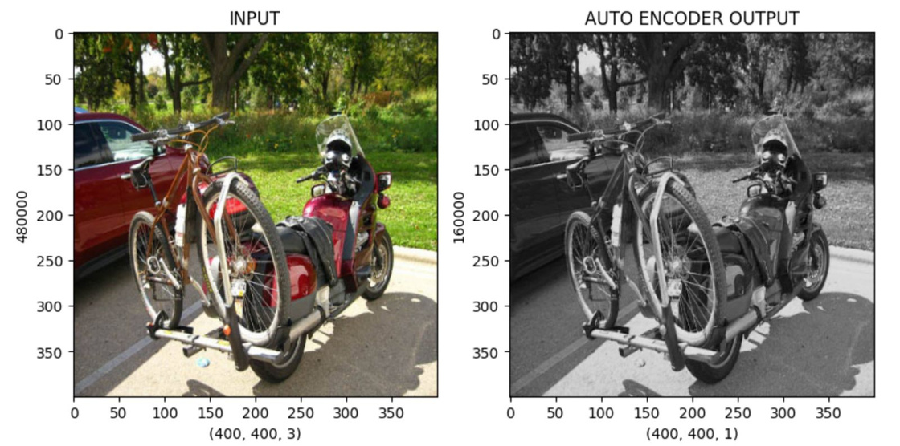
RESULTS
SAMPLE OUTPUT
HUE WIZARD

Slide 9
THANK'S FOR WATCHING
HUE WIZARD

